Slide 1
Team 1: Calendar
Teddy Sosnowski, Chris Wilson, Alex Wimer, and Connor Mahaffey

Slide 2
Functional Requirements
1. The calendar function shall allow the user to interact with the calendar:
1.1 The system shall support the user to zoom in and out for day to week to month to yearly views
1.2 The system shall support the use of scroll functions when needed
1.3 The system shall allow the user to see a summary of multiple days events on the month/week/yearly view.
1.4 The system shall allow the user to touch on a specific day and see detailed events to take place
1.5 The system shall allow the user to switch from calendar view to agenda view
1.6 The system shall assign special colors to holidays and weekends
1.7 The system shall allow reset of all events from a settings popup.

Slide 3
Functional Requirements
2. The events function shall allow the user to create/edit/delete desired events:
2.1 The system shall allow the user to call the create function for a new event
2.2 The system shall allow the user to call the edit function on a desired event
2.3 The system shall allow the user to call the delete function on existing event
2.4 The events function shall incorporate created event into existing calendar events
2.5 The events function shall check time/date conflict from created events and notify user by applying color code to conflicting events

Slide 4
Functional Requirements
3. The create function shall allow the user to create an event:
3.1 User shall assign time category for the event (all day or time window).
3.2 The edit function shall allow user to add information pertaining to the event including time, date, occurrence, and category.
3.3 The create function shall assign color code based on category and time widow.

Slide 5
Functional Requirements
4. The edit function shall allow the user to edit an existing event:
4.1 The edit function shall import all data of a user selected event
4.2 The edit functions shall call the delete function before returning the edited event to the events function
5. The delete function shall allow the user to delete an existing event:
5.1 The delete function shall post a popup to the user for conformation
5.2 The delete function shall ask (if periodical) to delete all related events or single occurrence

Slide 6
Functional Requirements
6. The View function shall allow the user the change the view:
6.1 The view function shall allow the user to change from day to week by zooming out or touch for week to day
6.2 The view function shall allow the user to change from week to month by zooming out or touch for month to week 6
.3 The view function shall allow the user to change from month to year by zooming out or touch for year to month
6.4 The view function shall allow switching to agenda view from a button on current view
6.5 The view function shall allow switching from agenda view to last know view by a button

Slide 7
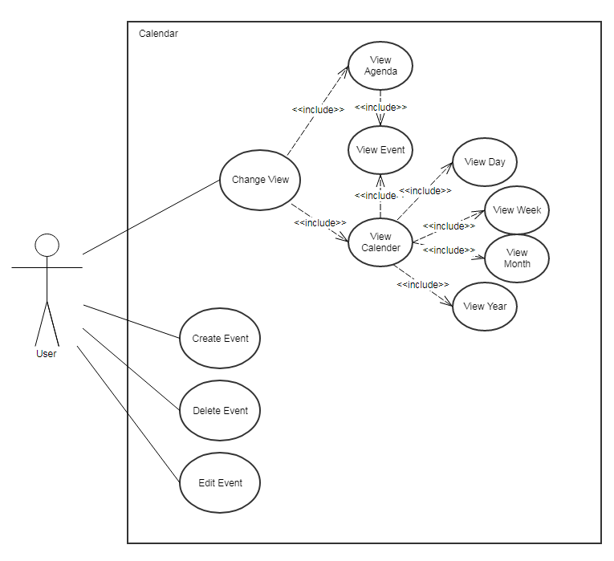
Use Case Diagram

Slide 8
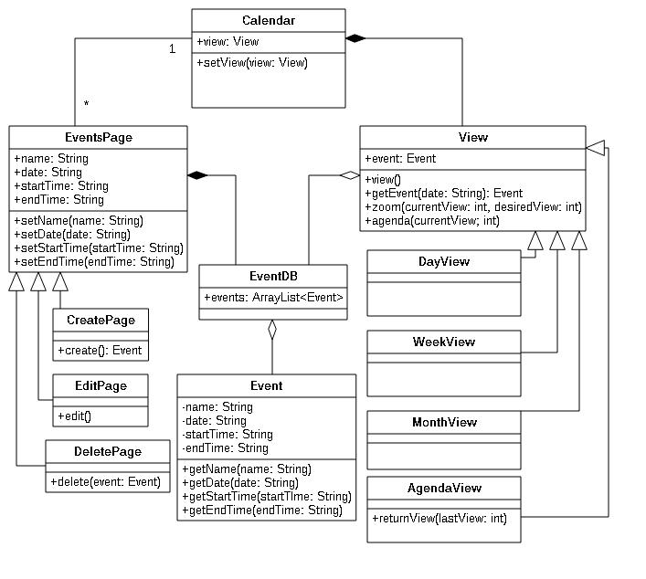
Class Diagram

Slide 9
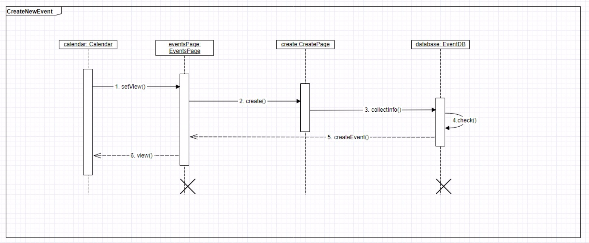

Slide 10
